Slide 1
Interview Task -DS Intern
Prepared by
Femi K J

Slide 2
PROBLEM STATEMENT
Identify potential customer segmentation and provide some meaningful insights from each segment.
what decision company should take based on the data insights ?
Demonstrate your understanding of the data.
Do EDA (Exploratory Data Analysis ) and provide a summary
Explain you data modelling approach.
What sort of modelling & segmentation is best fit for this data?
Please find out the customers who are 'champions' , 'Potential customers' and 'need attention'

Slide 3
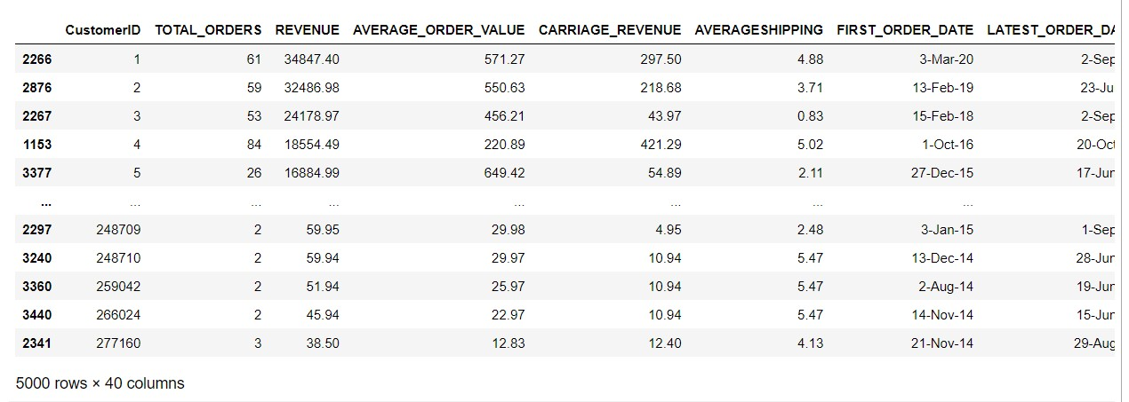
dataset
It consist of 5000 rows and 40
columns
'CustomerID', 'TOTAL_ORDERS', 'REVENUE', 'AVERAGE_ORDER_VALUE', 'CARRIAGE_REVENUE', 'AVERAGESHIPPING', 'FIRST_ORDER_DATE', 'LATEST_ORDER_DATE', 'AVGDAYSBETWEENORDERS', 'DAYSSINCELASTORDER', 'MONDAY_ORDERS', 'TUESDAY_ORDERS', 'WEDNESDAY_ORDERS', 'THURSDAY_ORDERS', 'FRIDAY_ORDERS', 'SATURDAY_ORDERS', 'SUNDAY_ORDERS', 'MONDAY_REVENUE', 'TUESDAY_REVENUE', 'WEDNESDAY_REVENUE', 'THURSDAY_REVENUE', 'FRIDAY_REVENUE', 'SATURDAY_REVENUE', 'SUNDAY_REVENUE', 'WEEK1_DAY01_DAY07_ORDERS', 'WEEK2_DAY08_DAY15_ORDERS', 'WEEK3_DAY16_DAY23_ORDERS', 'WEEK4_DAY24_DAY31_ORDERS', 'WEEK1_DAY01_DAY07_REVENUE', 'WEEK2_DAY08_DAY15_REVENUE', 'WEEK3_DAY16_DAY23_REVENUE', 'WEEK4_DAY24_DAY31_REVENUE', 'TIME_0000_0600_ORDERS', 'TIME_0601_1200_ORDERS', 'TIME_1200_1800_ORDERS', 'TIME_1801_2359_ORDERS', 'TIME_0000_0600_REVENUE', 'TIME_0601_1200_REVENUE', 'TIME_1200_1800_REVENUE', 'TIME_1801_2359_REVENUE'

Slide 4
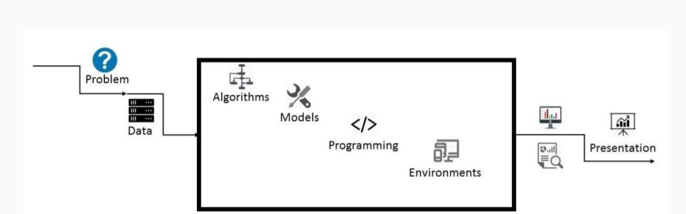
Architecture
Analyze the dataset and
define customer segments based on consumption behaviors using machine learning and dimensionality reduction.
Several unsupervised tools are implemented:
K-Means. Optimal number of segments are determined using Elbow method.
PCA (Principal Composant Analysis). Apply dimensionality reduction.

Slide 5
Requirements
Hardware Requirements
Processor : Intel(R) Core(TM) i3-1005G1 CPU
@ 1.20GHz 1.19 GHz
Main Memory : 4.00 GB
System Type : 64-bit operating system
Software
Operating System : Windows 10
Programming Tool : Pandas, Matplotlib ,Seaborn, Plotly
Software’s used : Jupyter Notebook
Back End : Python

Slide 6
METHODOLOGY
Creating an approach to solve the given problem statement
Exploring the dataset and obtaining useful insight from the same
Cleaning the dataset by handling nan values, remove duplicate records, etc.
Data Visualization used to obtain important information from the data
Data Preprocessing is performed to make the data ready to fit the model
Model Building

Slide 7
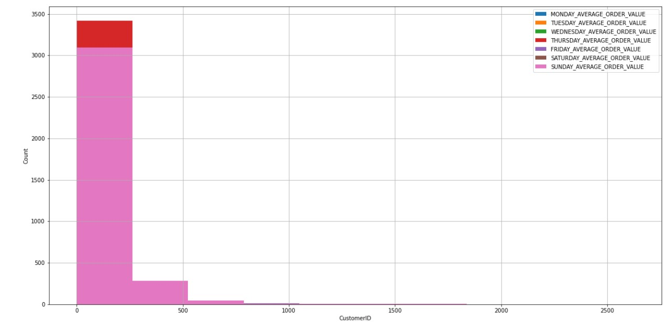
Implementation and Analysis
Day wise Analysis
From this histogram , we can say that most of people like to order on sunday and there are some customer like to order on Thursday

Slide 8
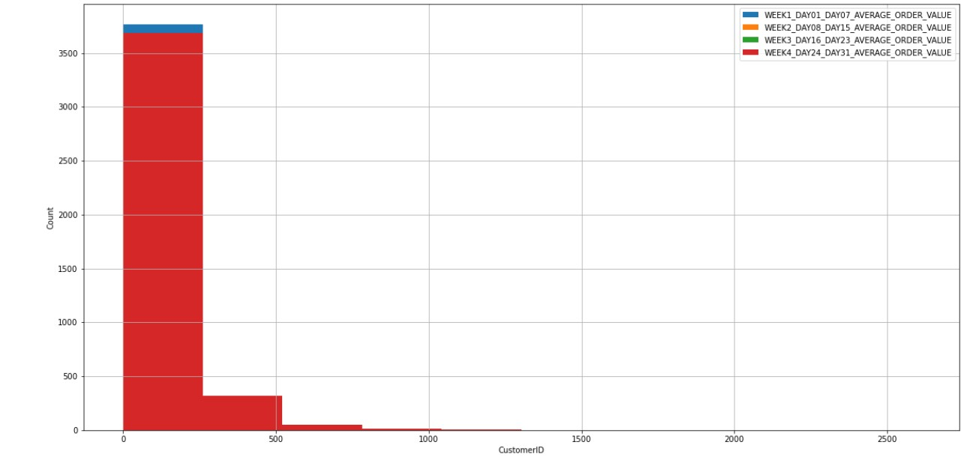
Implementation and Analysis
Week wise Analysis
From this histogram , we can say that most of customer like to order in week 4 and there are few customers like to order on week 1.

Slide 9
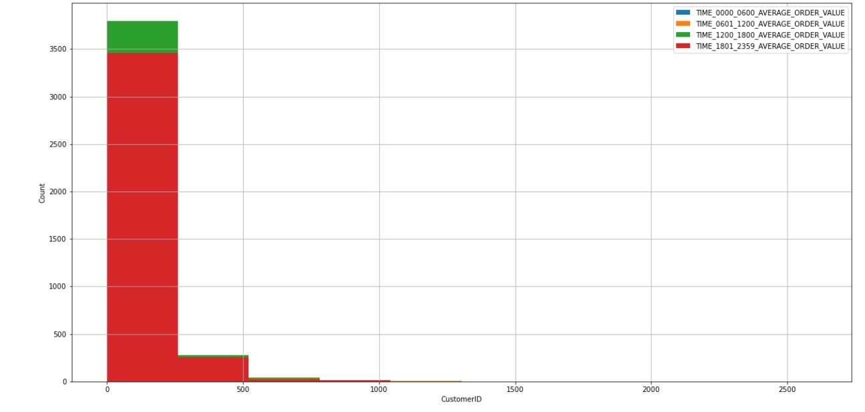
Implementation and Analysis
Time wise Analysis
From this histogram , we can say that all customer like to order on after noon time and all customer like to purchase on evening time also.
From all this visualization , we can say that the company have more revenue on last sunday of each month at after noon.

Slide 10
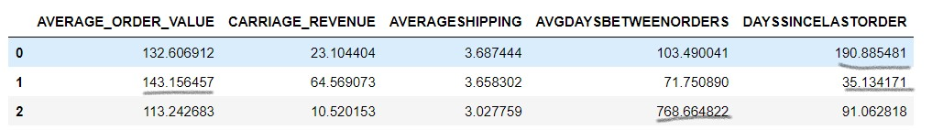
results
Identified customer segments:
First customer cluster(Potential customers ) which day since last order is very high
Second customer cluster(Champions )which average order value is very high and average day between orders , day since last order is low.
Third customer cluster (Need Attention) which average day between orders is very high

Slide 11
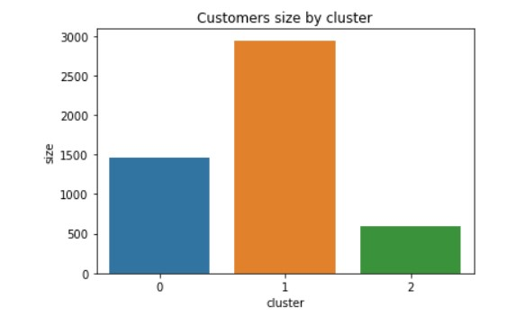
Population per segment:
Clearly the cluster 0 are extremely small .ie, Low active customers are very small amound and they need attention The cluster 1 are very high , which is highly active purchaser. Also cluster 2 are medium which is potential customers.

Slide 12
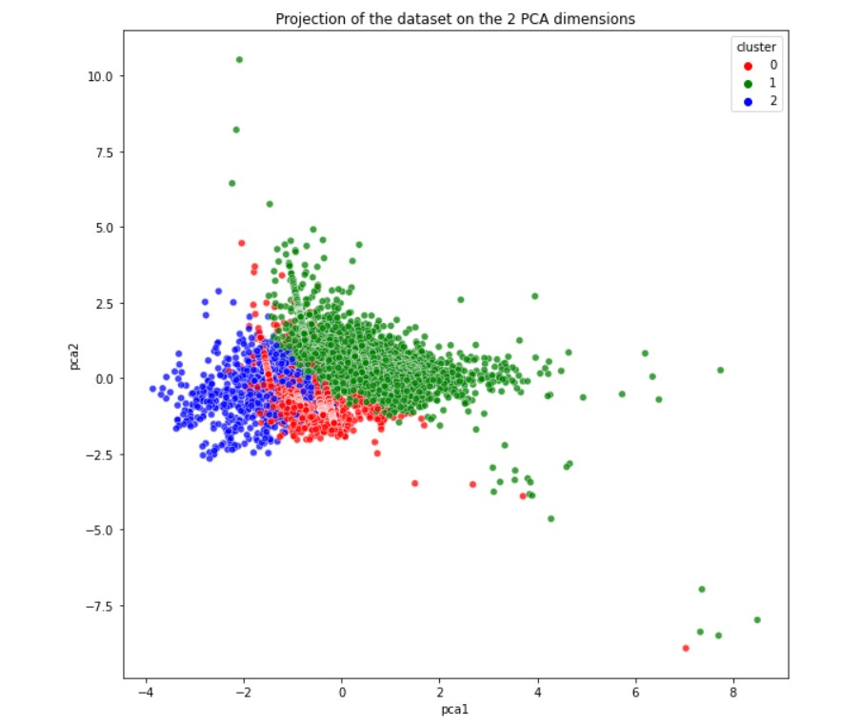
The dataset projection on two principal component axis after dimensionality reduction towards 2D feature space (from 17 features to 2 features). These two dimensions retain 48% of the total variance of the dataset. The axes represents the direction of maximum variance in the data (eigen vectors).

Slide 13
Suggetions
Cluster 1 customers : Target these customers by sending new product alerts which would lead to an increase in the revenue.
Cluster 0 customers: Target these customers by asking the feedback and advertising the product in a better way to convert them into Cluster 1 customers.
Cluster 2 customers: Don't target these customers since they are not active.

Slide 14
THANK YOU

